Slide 1












Introduction to GitHub Actions
Kathi Kellenberger
She/her
Customer Success Engineer
Redgate Software

Slide 2
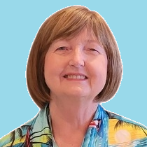


Kathi
Kellenberger
He/Him
Customer Success Engineer
I’ve worked with SQL Server for 25 years as a developer, DBA, and now at Redgate. I’m a former Data Platform MVP and love to present and write about SQL Server. You can find my work on Amazon and Pluralsight.
Redgate Software
Kathi.Kellenberger@red-gate.com
Linkedin.com/in/kathikellenberger

Slide 3
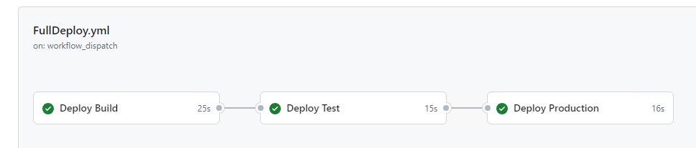
What's GitHub Actions?

Slide 4
My setup
Azure VMs
1 VM with multiple roles
Flyway Community (free, open-source) owned by Redgate

Slide 5
DEMO!

Slide 6
GitHub Actions Components
Workflows
Actions
Variables and secrets
Jobs
Triggers
Runners
Environments

Slide 7
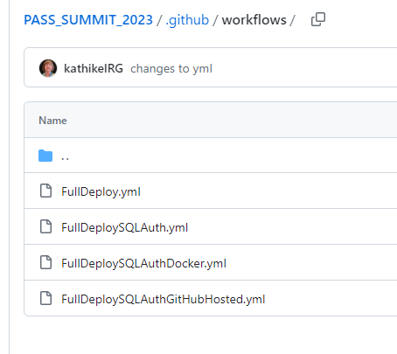
Workflows: Files

Slide 8
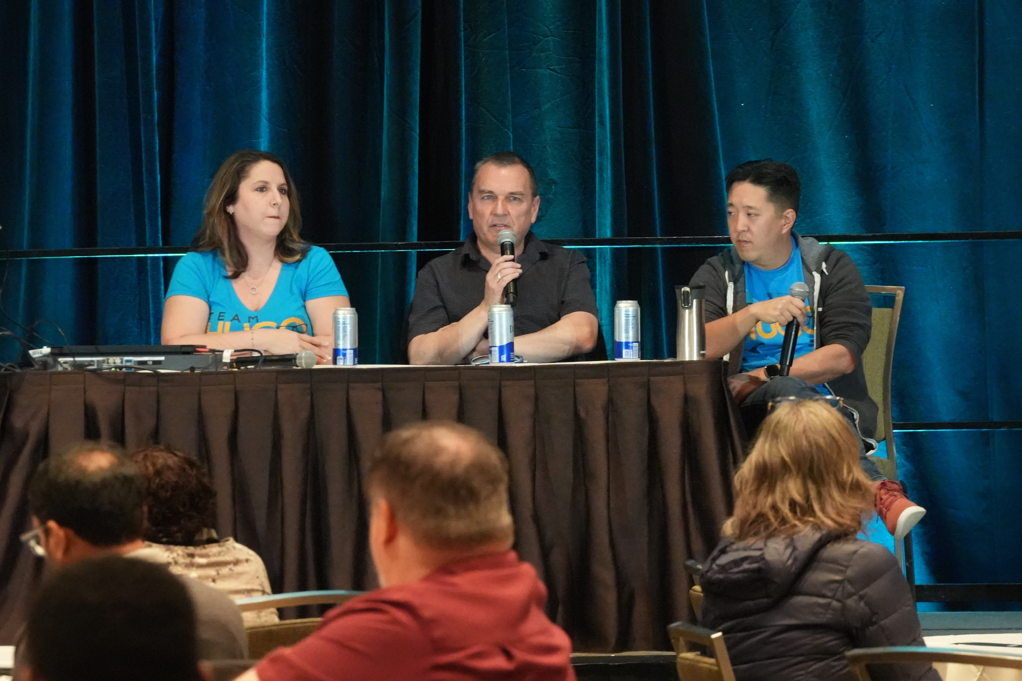
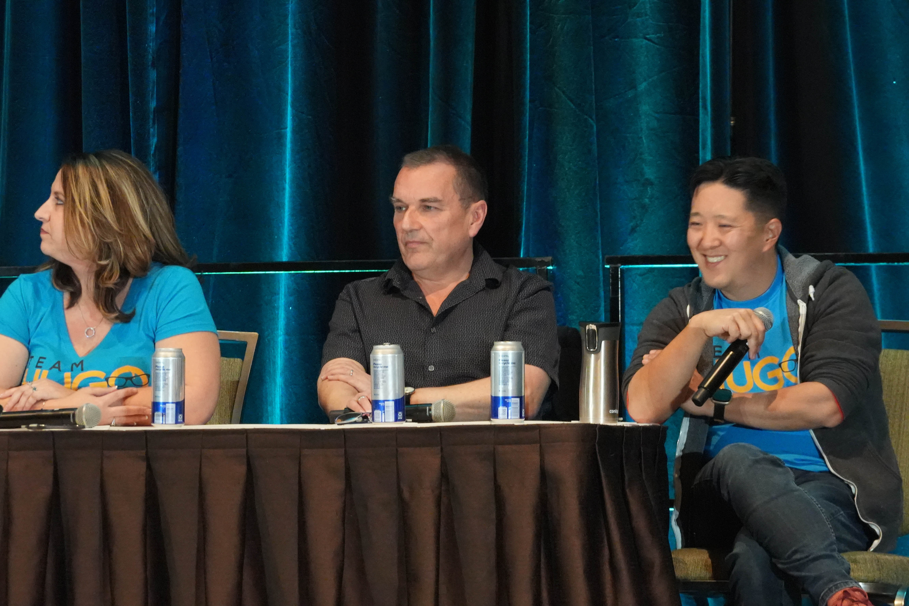
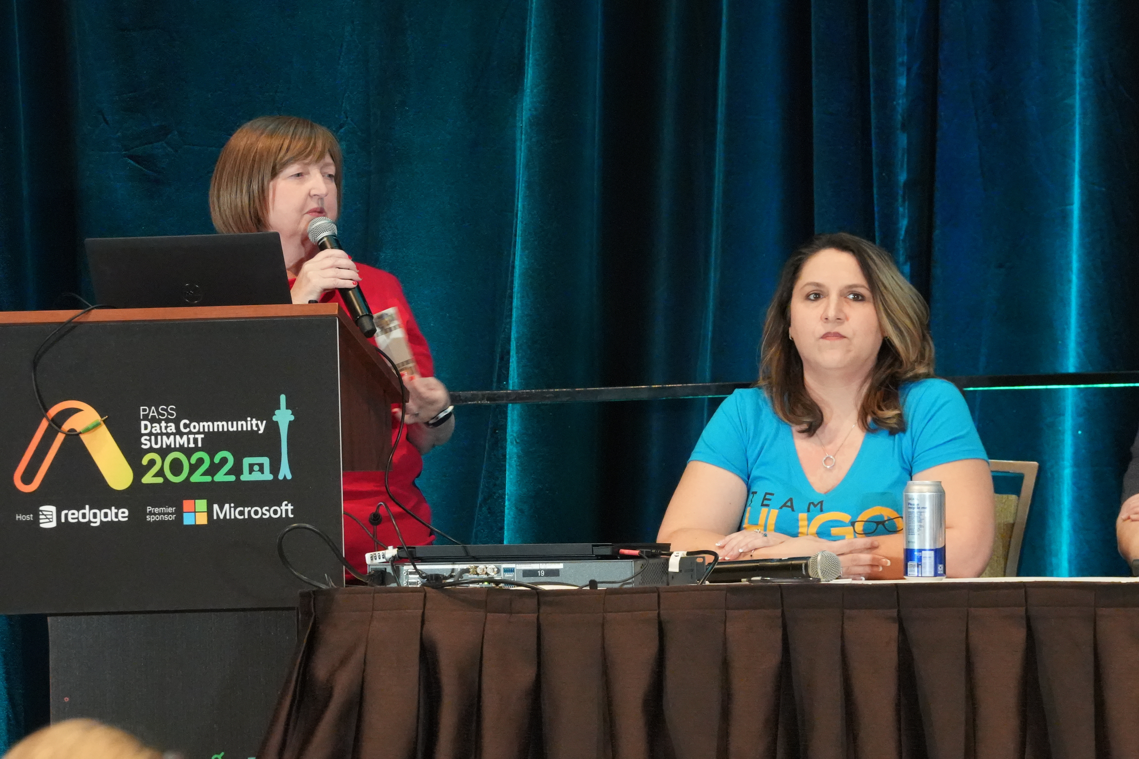

Slide 9
YAML
Yet another markup language
YAML ain't markup language
YAML is UNFORGIVING!!
Use VSCode to edit
Extra spaces and tabs break yaml

Slide 10
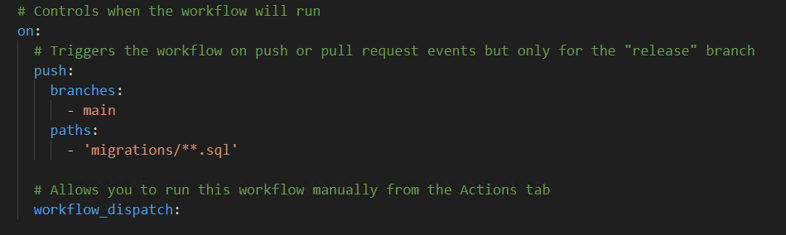
Triggers

Slide 11
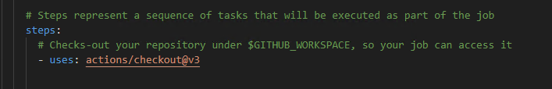
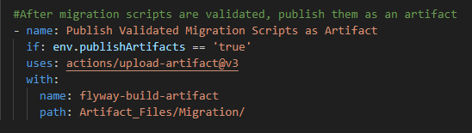
Actions

Slide 12
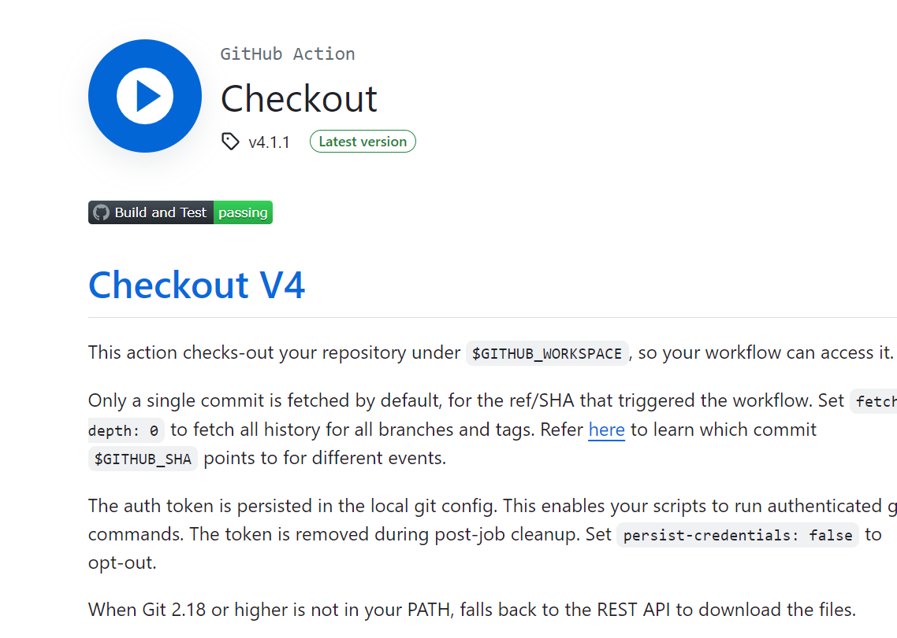
Actions

Slide 13
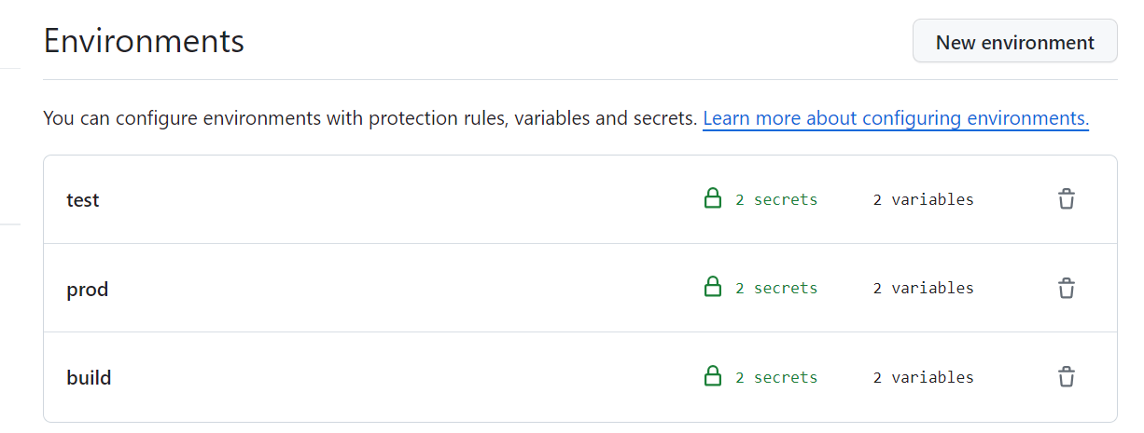
Environments

Slide 14
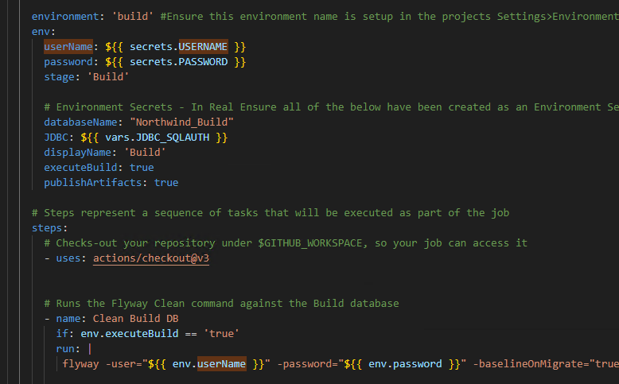
Variables and secrets

Slide 15
Repo
env:
Var1: ${{ vars.Var1 }}
Var2: Server1
Var3: ${{ secrets.secret1 }}
jobs:
build:
environment: build
env:
JobVar1: ${{ secrets.EnvironmentSecret }}
JobVar2: ${{ vars.EnvironmentVariable }}
steps:
run: cmd ${{ env.Var1 }} ${{ env.JobVar2 }}

Slide 16
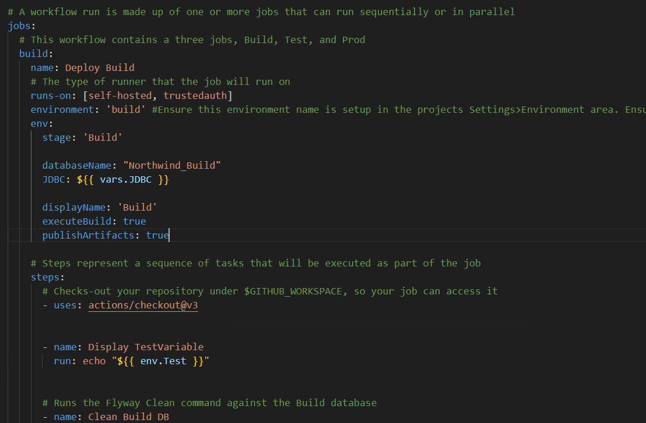
Jobs

Slide 17
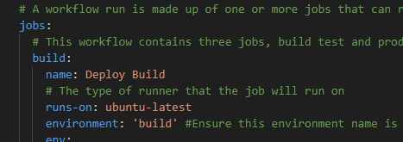
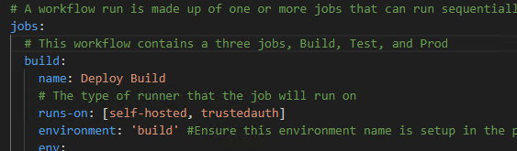
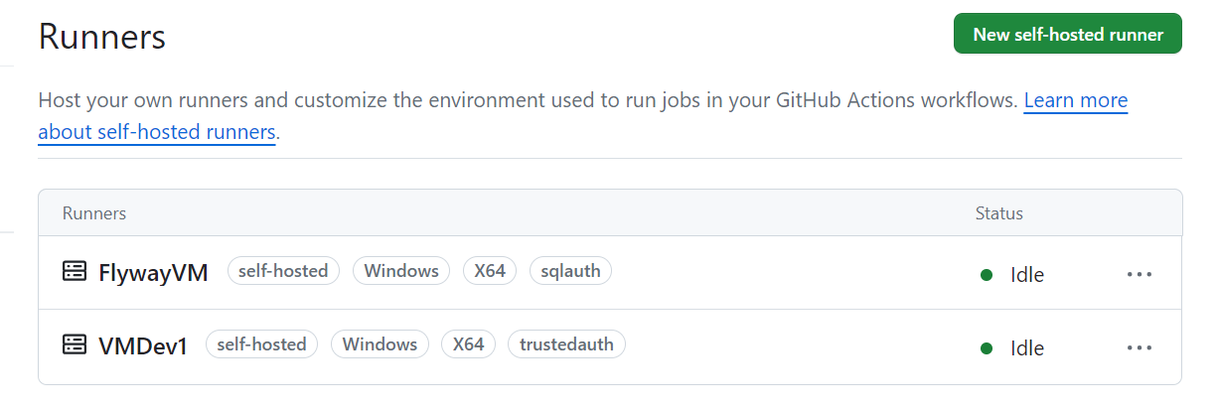
Runners

Slide 18
Summary
Workflows are YAML files
.github/workflows
Jobs and job steps
Environments
Secrets and variables
Runners

Slide 19
Resources
https://github.com/kathikelRG/PASS_SUMMIT_2023
Building JDBC connection string
Udemy GitHub Actions course
Udemy YAML course
Reusable workflows
GitHub Actions Marketplace
Triggers
Kerberos on Linux for GitHub hosted runners

Slide 20
Set up demo
Create fork from github.com/kathikelrg/pass_summit2023
Set up databases, such as Azure SQL DB, Azure VMs, RDS, etc.
Set up environments, secrets, and variables
Set up runners

Slide 21


Slide 22
Kathi Kellenberger
Kathi.Kellenberger@red-gate.com
Linkedin.com/in/kathikellenberger
Find me at Booth #100
Professional Power Hour: Career Change with Kendra Little
Friday 1:00 PM Community Zone

